Slide 1
Any software problem can be solved by adding another layer of indirection.
Steven M. Bellovin
--
The two software problems that can never be solved by adding another layer of indirection are that of providing adequate performance or minimal resource usage.
Jeff Kesselman

Slide 2
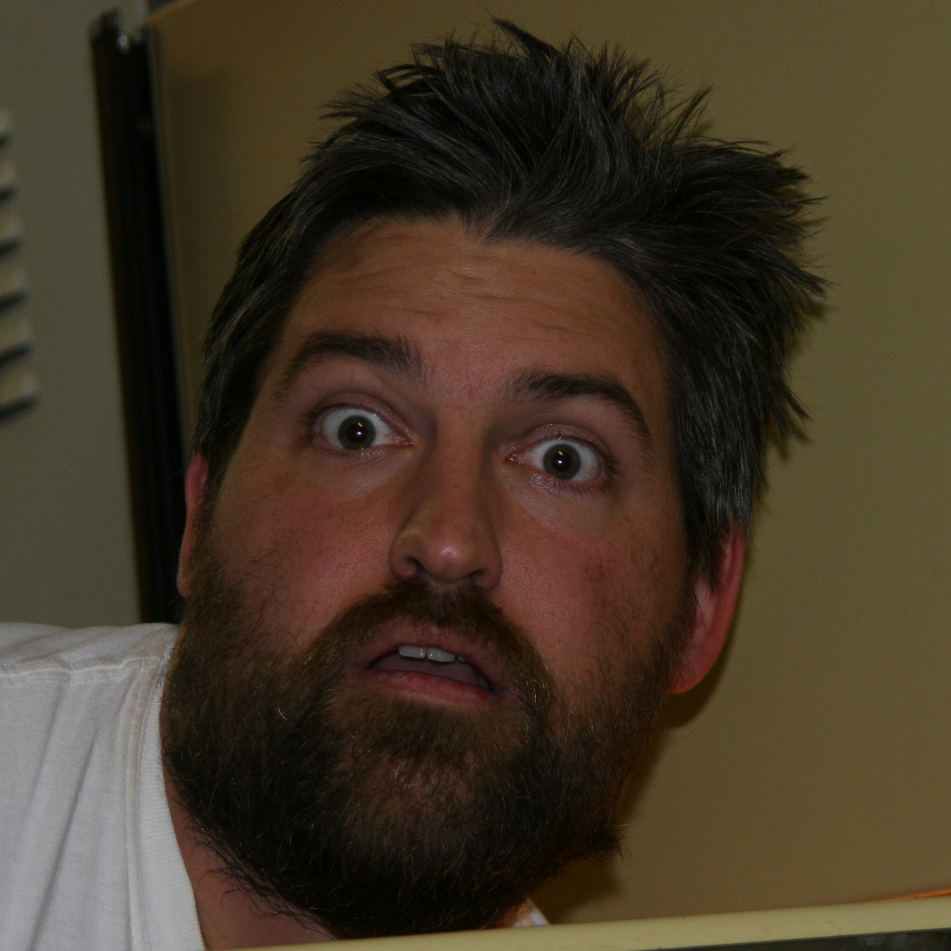
@Hoggarth
http://twitter.com/Hoggarth
http://twitter.com/\#search\?q\=%23TCJUG

Slide 3
There are more “informative” slideshows out there.
http://www.slideshare.net/pizak/fast-soa-with-apache-synapse
http://www.slideshare.net/hiranya911/introduction-to-apache-synapse
http://www.slideshare.net/jfhelie/apache-synapse-171322
http://www.slideshare.net/guest60ed0b/aceu2009-apache-synapse-events

Slide 4
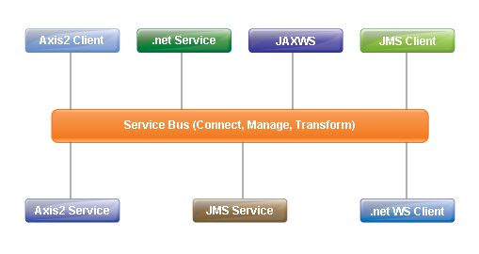
Enterprise Service Bus

Slide 5
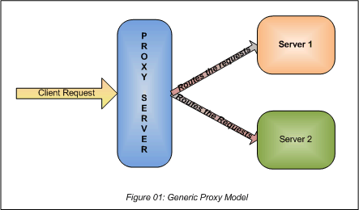
Generic Proxy Model

Slide 6
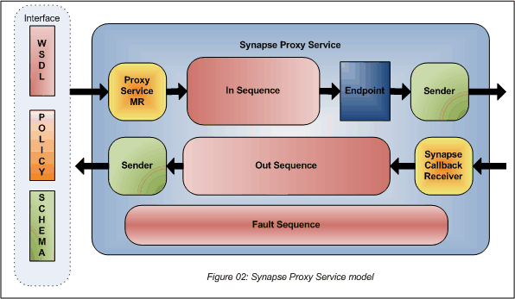
Synapse Proxy Service

Slide 7




Books I Might Finish One Day
Open Source SOA, Jeff Davis
Enterprise Integration Patterns, Gregor Hohpe and Bobby Woolf
SOA Design Patterns, Thomas Erl
Open Source ESBs in Action, Tijs Rademakers and Jos Dirksen

Slide 8
Thanks Concur
See me about that job
Contact me about Synapse
http://twitter.com/hoggarth
hoggarth@gmail.com

